Slide 1
Analysis of Rocketbook Sales Data (June-July 2020) and Suggestions
Steven Zhao 4/7/2022

Slide 2
Assumptions
Before I begin, I’d like to clarify some of the assumptions I make throughout this report:
For Question 1, I interpreted “dollar value” as meaning the total transaction value, including shipping and taxes.
For the rest of this report, I interpret “Order Value” as:
(Line item price * Line item quantity) – discount
I do this for a few reasons:
We want to find consumers most willing to give Rocketbook money, not the government or shipping companies.
Taxes and average shipping costs vary significantly by location, and introduce noise into the data.
In cases where the discount is greater than the price * quantity (e.g. the Order Value becomes negative), I truncate the Order Value to equal $0.

Slide 3
Most Popular Payment Method
By both count and dollar value, Shopify Payments was easily the most popular payment method, accounting for ~60% of both.

Slide 4
Marketing and Order Value
Customers who agreed to marketing had a higher average and median Order Value.
This makes sense: people who accept marketing are more likely to be enthusiastic about Rocketbook’s products and are thus more willing to spend.
Statistical summary of customers who did agree to marketing
Average: | $29.60
Median: | $31.45
Standard deviation: | $31.20
Minimum: | $0.00
Maximum: | $1011.50
Statistical Summary of customers who didn’t agree to marketing
Average: | $27.66
Median: | $29.00
Standard deviation: | $36.47
Minimum: | $0.00
Maximum: | $867.00

Slide 5
We can look at the relative frequency distributions for an even more detailed representation…

Slide 6
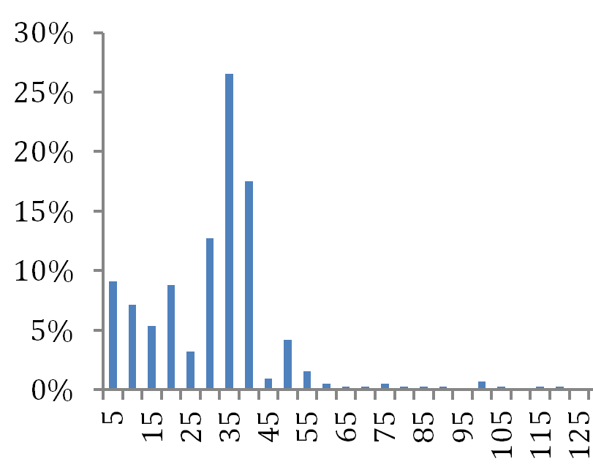
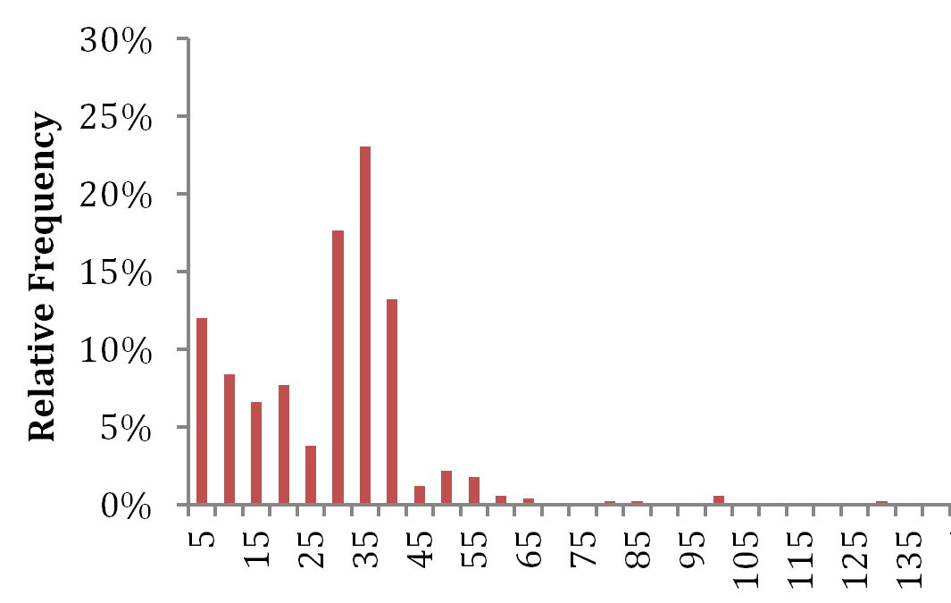
Temporarily removing outliers to better observe the two distributions, we see that consumers who did not accept marketing are more likely to have bought lower value goods: consistent with our conclusion before.
“Yes” Relative Frequency Distribution (outliers removed)
“No” Relative Frequency Distribution (outliers removed)
Relative Frequency
Relative Frequency
Order Values ($)
Order Values ($)

Slide 7
Occupations and Revenue
Working Professionals generated the most revenue by far, accounting for ~54% of total revenue.
The next biggest group, Students, generated around 20% of revenue, a little more than a third of that for Working Professionals.
Occupation | Revenue | % of Total Revenue | Average Order Value
Working Professional | $13,799.05 | 54.29% | $26.69
Student | $5,024.50 | 19.77% | $28.23
Educator | $2,855.90 | 11.24% | $28.56
Creative/Writer | $2,024.80 | 7.97% | $31.64
Other | $1,507.15 | 5.93% | $30.14
Undefined | $204.00 | 0.80% | $34.00

Slide 8
Additionally, out of all clearly-defined professions, Creative/Writers had the highest Average Order Value.
Educators and Students had similar AOVs.
Working Professionals had the lowest AOV.
Occupation | Revenue | % of Total Revenue | Average Order Value
Working Professional | $13,799.05 | 54.29% | $26.69
Student | $5,024.50 | 19.77% | $28.23
Educator | $2,855.90 | 11.24% | $28.56
Creative/Writer | $2,024.80 | 7.97% | $31.64
Other | $1,507.15 | 5.93% | $30.14
Undefined | $204.00 | 0.80% | $34.00

Slide 9
Last notes on the “Occupation and Revenue” data:
While figures for larger groups like Professionals and Students should be relatively reliable, due to the overall small sample size of overlapping IDs, statistics for smaller groups may be inaccurate.
For example, Undefined has a high AOVs, but its sample size is far too small to be reliable.

Slide 10
Marketing Strategy: Occupation
Rocketbook should strongly market to working professionals, who account for most of Rocketbook’s sales.
Working professionals care most about increasing productivity. Rocketbook can accordingly market its products as boosting productivity in two ways:
Rocketbook can boost individual productivity through its handy app To-Do-Lists and pages tailored to planning and note-taking.
Rocketbook can boost collective productivity since it streamlines sharing information (e.g. schedules, meeting notes) so well.

Slide 11
As such, Rocketbook should market products such as the Fusion, the Panda Planner and Everyday Planner. These products are suitable for both scheduling and writing notes, and of course can share information through the Rocketbook app.
Rocketbook can also market the Orbit for its customizable Page Packs that can take on the wide-range of tasks needed in the professional world, including creating schedules.
Since most consumers are working professionals, Rocketbook can also consider B2B marketing, providing products to employees at large or small enterprises at wholesale prices.
This would improve workplace efficiency for companies.
It would also help the company go green, and as such, Rocketbook can target environmentally-minded businesses in particular

Slide 12
Rocketbook should also market to Students, who account for a still-significant portion of revenue and have a higher AOV than Working Professionals.
Of course, normal products with strong note-taking capabilities and/or planning capabilities could be marketed, e.g. the Core and Fusion.
Rocketbook could also market its more specialized products.
The Academic Planner is obviously tailored towards students.
The Matrix could be helpful for students in STEM
Cloud Cards could help students with memorization
Rocketbook could also collaborate with schools to distribute notebooks to students (also marketing to Educators in the process).

Slide 13
Rocketbook can also consider marketing to Creatives/Writers. While their share of revenue is low, their high AOV makes them attractive target market.
Of course, the AOV may be inflated by the smallness of the sample size I analyzed.
Problem: Creatives/Writers often prefer working on paper. However, they also need to send their work digitally to others.
Solution: Rocketbook allows people to seamlessly work on “paper” and easily transfer their work online.
Particularly, the Flip can be marketed to artists as it is similar to a sketchbook. The music staff Page Packs can be marketed to composers.
Naturally, the market size for creatives is likely much smaller than that of professionals and students. And considering that marketing towards creatives needs to be tailored to whatever art they do, working professionals and students should remain the primary marketing targets.

Slide 14
Marketing Strategy: Device
Unsurprisingly, Apple accounts for most revenue. Samsung also accounts for a significant portion.
This is largely a result of Rocketbook primarily operating in countries where Apple is more popular (e.g. the U.S.).
For now, Rocketbook can partner with retailers of Apple and Samsung products to, for example, sell devices and Rocketbooks as a package together.
As Rocketbook expands internationally, Rocketbook should consider collaborating with phone brands more popular in other countries.
Device | Revenue | % of Total Revenue | Average Order Value
Apple | $15,422.20 | 60.68% | $28.35
Samsung | $5,759.00 | 22.66% | $28.94
Other | $4,234.20 | 16.66% | $26.14

Slide 15
Marketing Strategy: Country
Unsurprisingly, the U.S., Canada, the U.K. and Mexico dominate revenue, accounting for ~90%.
While sample size for most regions was too small to be reliable, clearly most sales are concentrated in Europe and North America.
Only countries in South Asia and Africa with data were India and South Africa.
Country | Revenue | % of Total Revenue | Average Order Value
U.S. | $20,328.00 | 79.98% | $27.73
Canada | $1,263.20 | 4.97% | $31.58
Great Britain | $724.30 | 2.85% | $32.92
Mexico | $567.30 | 2.23% | $24.67
Region | Revenue | % of International Revenue | Average Order Value
Europe | $1,983.85 | 39.00% | $28.34
North America | $1,969.45 | 38.71% | $28.96
East Asia | $285.75 | 5.62% | $21.98
Oceania | $244.00 | 4.80% | $27.11
South America | $232.40 | 4.57% | $25.82
Middle East | $207.95 | 4.09% | $29.70
South Asia* | $65.00 | 1.28% | $32.50
Africa* | $99.00 | 1.95% | $24.75

Slide 16
Not including the U.S., English-speaking countries also made up ~51% of international revenue:
Countries that I considered to commonly understand English include Canada,
the U.K., Ireland, Australia, New Zealand, Singapore, South Africa, India and Belize.
To summarize, Rocketbook’s sales tend towards countries that are North American or European, and can speak English. This makes sense:
Countries in North America/Europe are relatively close and easier to ship to
It is easier to market to countries that are in the West/English-speaking because they are relatively similar to the U.S.
Consumers in these areas more often have the purchasing power necessary to buy Rocketbooks
 | Revenue | % of International Revenue | Average Order Value
English-speaking | $2,603.15 | 51.17% | $30.99
Non-English-speaking | $2,484.25 | 48.83% | $25.35

Slide 17
For now, Rocketbook should focus on the North American/European/English-speaking countries that make up the bulk of its international revenue:
At the same time, Rocketbook should try to tailor marketing to specific consumer culture/habits in each country.
Sales in other countries lag more due to difficulty of marketing + expensiveness of Rocketbook products.
Nevertheless, from my own experience abroad, I believe there is room for expansion outside of the West. One possible strategy would be to market Rocketbook products as high-end goods to justify the price, targeting well-off consumers.
As mentioned before, Rocketbook can also partner with phone retailers popular in different countries, marketing at the same time towards international consumers and device users.

Slide 18
That concludes my analysis.
Thank you for reading, and have a wonderful day!

